Slide 1
CS 2600 Computer Networks I Dr. Sayeed Sajal Lecture 19 CSMA/CD

Slide 2
Flowchart for CSMA/CD Transmitter Algorithm

Slide 3
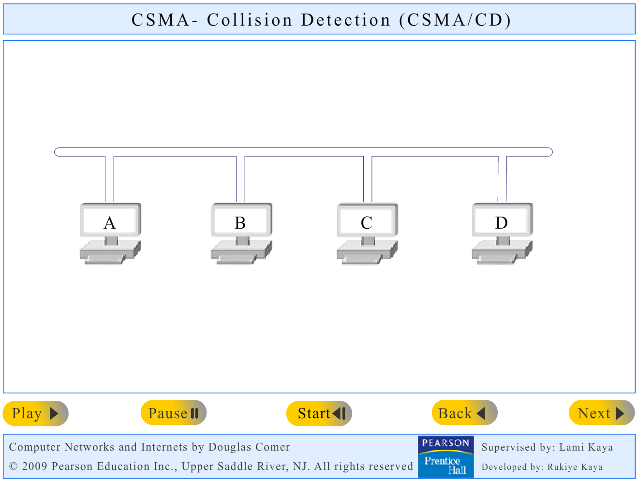
Ethernet Animation: Collision Detection*
This demonstrates a collision and the backoff algorithm illustrated on the
previous slide.
*Click the image to run the animation

Slide 4
Minimum Frame Size
64 bytes = 512 bits, so at 10Mbps it takes 51.2µs to transmit a minimum sized frame (512 bits ÷ 10⁷ bps ≈ 51.2µs). Since any frame must be at least 512 bits long, and the two-way volume of the pipe is less than 512 bits, this guarantees that all adapters involved in a collision will still be transmitting when the collision reaches them. Sensing the collision effectively acts as a “NAK”.

Slide 5
Switched Ethernet
10BASE-TX
The “X” in TX indicates “switched”
Dedicated 10Mbps connections between nodes (no more shared bus)
The hub was replaced by a switch, which contains memory that can store frames temporarily
Guaranteed bandwidth (eliminates contention present in a hub)
Makes the non-deterministic behavior of previous Ethernets more predictable
Easy to retrofit into existing LAN (only requires replacing hub with a switch)
100BASE-TX
100Mbps
Uses same CSMA/CD media access control & frame format as 10Mbps
Requires new 100BASE-TX switches & adapters)
CAT 5 cable or better

Slide 6
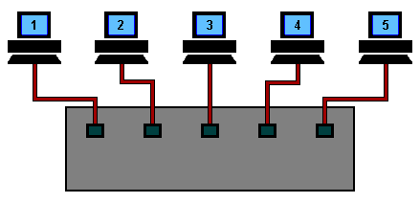
Ethernet Animation: Signal Flow with a Switch*
*Click the image to run the animation
http://www.datacottage.com/nch/anigifs/eswani.gif

Slide 7
The Evolution of Ethernet

Slide 8
(Test 2 Material Ends Here)

Slide 9

Recommended 802.11 Wi-Fi Reference

Slide 10
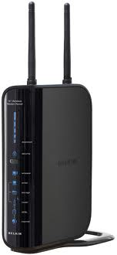
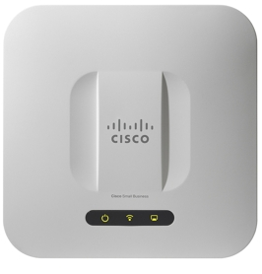
Cisco and Belkin Wireless Access Points

Slide 11
Applications for Wireless LANs
College campuses
Corporate networks
Internet access in public “hotspots”
Home networks
Temporary (“ad hoc”) networks
Urban network infrastructure (downtown, parks)
Warehouse picking
Manufacturing plants
Stock exchange trading floors
Historic buildings that prohibit cable installation

Slide 12
Quiz Next Time
Covers sliding window and Ethernet (lectures 16 - 19 and pages 106 – 110 and 119 - 128 in the text).

